Slide 1
REINFORCEMENT LEARNING BASED AUTOMATED PATH PLANNING IN GARDEN ENVIRONMENT USING DEPTH - 'RAPiG-D'
ZEROTH REVIEW
S SATHIYA MURTHI - 2018504604
PRANAV BALAKRISHNAN - 2018504581
C ROSHAN ABRAHAM - 2018504591
BE ELECTRONICS AND COMMUNICATION ENGINEERING
GUIDED BY:​
DR. V. SATHIESH KUMAR,​
ASSISTANT PROFESSOR,
DEPARTMENT OF ELECTRONICS ENGINEERING​
MIT CAMPUS, ANNA UNIVERSITY​

Slide 2
TABLE OF CONTENTS
Introduction
Motivation
Objective
Literature Survey
Methodology
Current Progress
Work plan
References
1

Slide 3
INTRODUCTION
Over the years, robots have been implemented in a wide range of applications and environments.
In turn, this has led to dealing with a host of environments that are increasingly dynamic and unknown.
Path planning with reinforcement learning would aid the automation of multiple tasks with minimal human intervention.
2

Slide 4
MOTIVATION
A learning based approach, can be used to navigate and map an unknown environment and trace the best possible path between any two points.
Stereo camera based depth mapping would be better suited to identify any type of obstacle.
Current methods are limited by their inability to adapt to new environments and varying obstacles.
3

Slide 5
OBJECTIVES
To develop a path finding algorithm that finds the best possible path between two paths in an unknown garden environment.
To perform hardware implementation of reinforcement learning based obstacle mapping and analyze its performance.
To perform detection of plant species using deep learning.
To develop an algorithm to explore all possible paths and determine the most efficient one.
To ensure that the robot avoids all obstacles and unnecessary detours.
4

Slide 6
LITERATURE SURVEY
AUTHOR NAME​ | TITLE​ | YEAR OF PUBLICATION​ | JOURNAL​ | DESCRIPTION​
Qingbiao Li , Fernando Gama , Alejandro Ribeiro , Amanda Prorok | Graph Neural Networks for Decentralized Multi-Robot Path Planning ​ | 2020 | IEEE/RSJ International Conference on Intelligent Robots and Systems | ​This paper proposed a convolutional neural network (CNN) that extracts adequate features from local observations. A graph neural network (GNN) that communicates these features among robots. Model is trained to imitate an expert algorithm and evaluate the method in simulations
5

Slide 7
LITERATURE SURVEY
AUTHOR NAME | TITLE | YEAR OF PUBLICATION | JOURNAL | DESCRIPTION
Martin Gromniak, Jonas Stenzel | Deep Reinforcement Learning for Mobile Robot Navigation | 2019 | Asia-Pacific Conference on Intelligent Robot Systems (ACIRS) | Developed training procedure, set of actions available, suitable state representation, and a reward function. Evaluated using a simulated real-time environment The experimental evaluation showed that DRL can be applied successfully to robot navigation.
6

Slide 8
LITERATURE SURVEY
AUTHOR NAME | TITLE | YEAR OF PUBLICATION | JOURNAL | DESCRIPTION
Jing Xin, Huan Zhao, Ding Liu | Application of Deep Reinforcement Learning in Mobile Robot Path Planning | 2019 | IEEE robotics and automation letters | A Deep Q-network (DQN) is designed and trained to approximate the mobile robot state-action value function and Q value corresponding to each possible mobile robot action is determined by the well trained DQN. The current optimal mobile robot action is selected by the action selection strategy to the goal point while avoiding obstacles ultimately
7

Slide 9
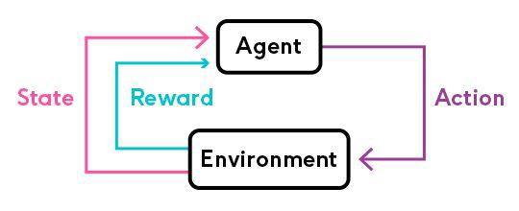
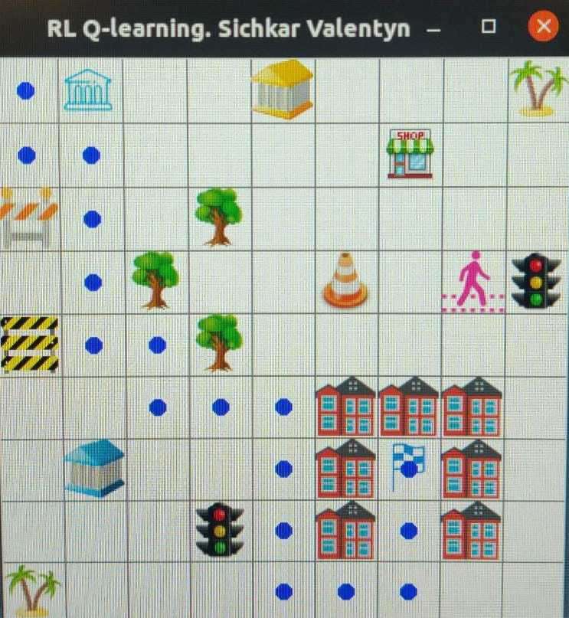
METHODOLOGY
Reinforcement learning is a machine learning training method based on rewarding desired behaviors and/or punishing undesired ones. In general, a reinforcement learning agent is able to perceive and interpret its environment, take actions and learn through trial and error.
Figure2: SARSA – Software Implementation
Figure1: SARSA Illustration
Reference: https://medium.com/@vishnuvijayanpv/what-is-reinforcement-learning-e5dc827c8564
8

Slide 10

METHODOLOGY
Stereo vision is the computation of depth based on the binocular disparity between the images of an object in left and right eyes
The Kinect camera is a motion sensing input device produced by Microsoft and first released in 2010. The device generally contains RGB cameras, and infrared projectors and detectors that map depth through either structured light or time of flight calculations, which can in turn be used to perform real-time gesture recognition and body skeletal detection, among other capabilities.
Image processing techniques are used to extract and utilize the depth map generated.
Figure1: XBOX 360 Kinect camera
Reference: https://en.wikipedia.org/wiki/Kinect
9

Slide 11
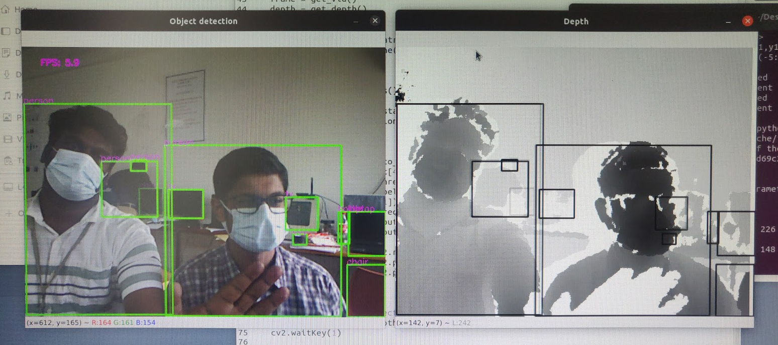
METHODOLOGY
Convolutional neural network (CNN) is a class of deep learning neural networks. They’re most commonly used to analyze visual imagery and are frequently used in image classification.
CNNs can therefore be used to detect and classify plants after collection of suitable dataset.
Models like YOLOv5 can be trained with custom data for the task
10

Slide 12
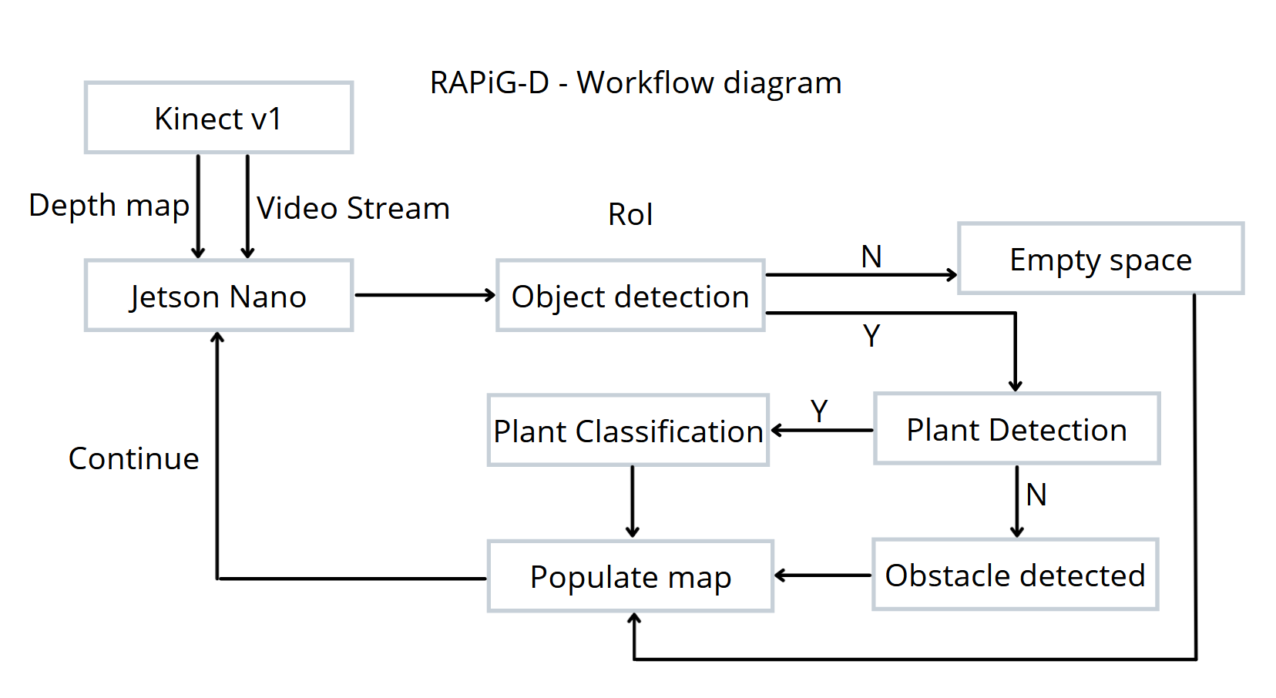
METHODOLOGY
11

Slide 13
COMPONENTS USED
COMPONENTS | SPECIFICATION | NUMBER USED
Jetson Nano | Developer Kit - 4GB | 1
Robot Chassis | Dimensions: 250 x 200 x 46 mm | 1
DC motor | 200 rpm 12V | 2
Wheels | Diameter-130mm Width-60mm | 4
Kinect v1 sensor |  | 1
Motor Driver IC | L298N | 1
IR sensor | 8 channel array | 1
Battery | 12V7A | 1
12

Slide 14
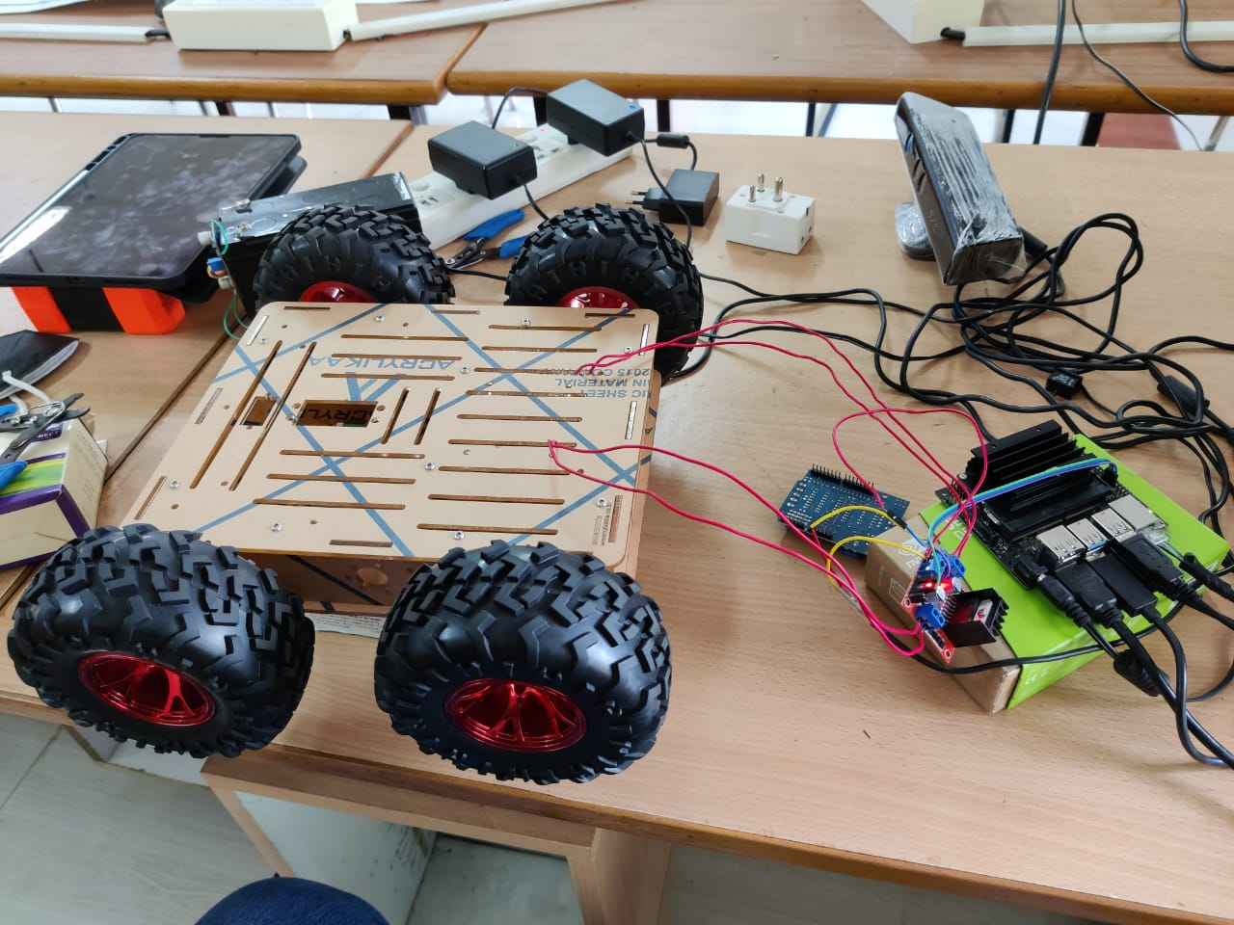
CURRENT PROGRESS
Tested software implementation of RL SARSA in PC.
Explored stereo camera and microcontroller options.
Initialized Jetson NANO and set up bot.
13

Slide 15
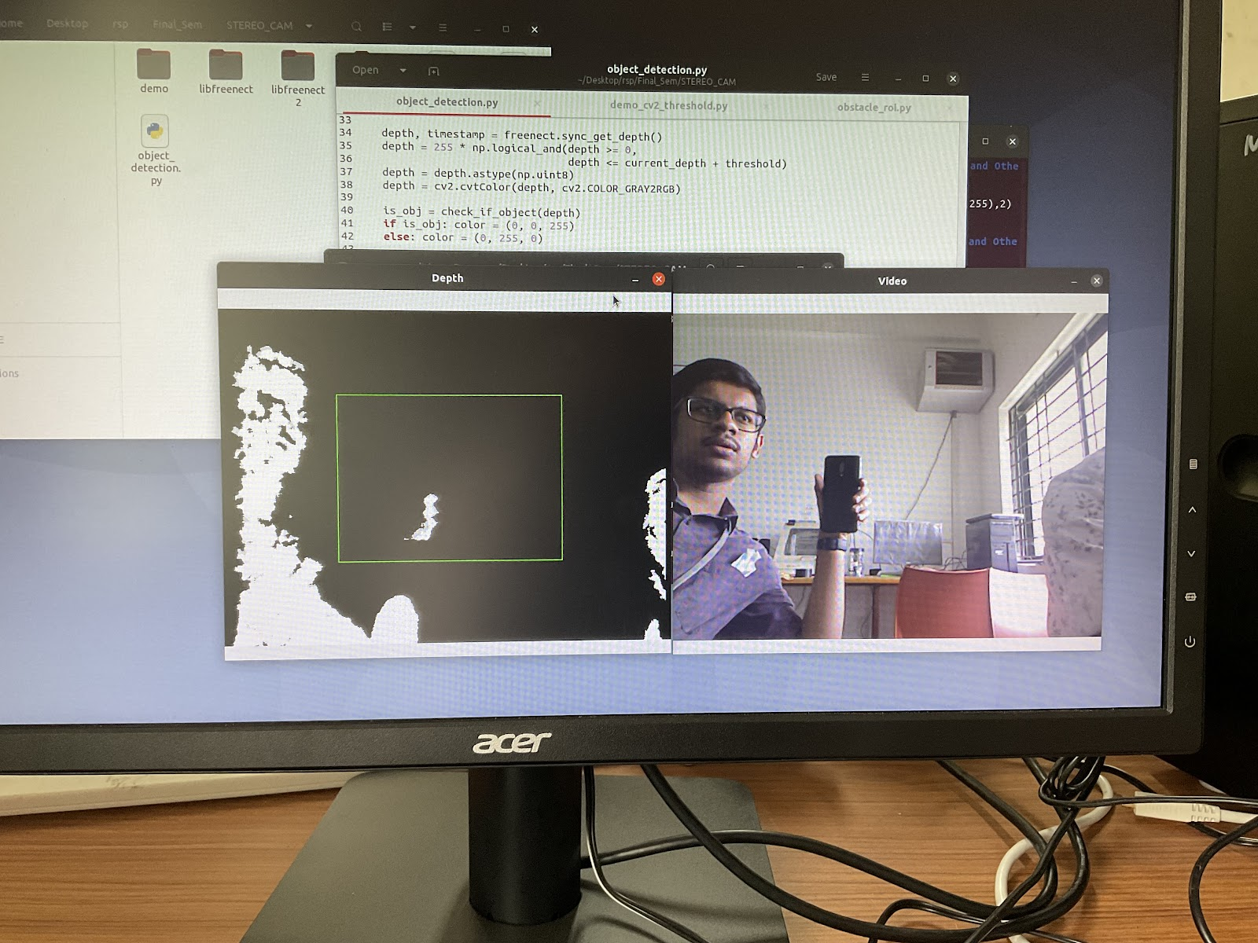
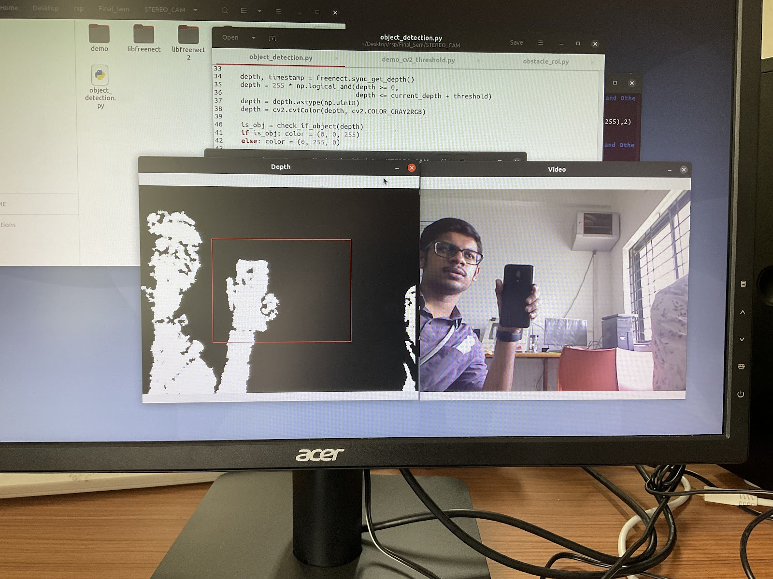
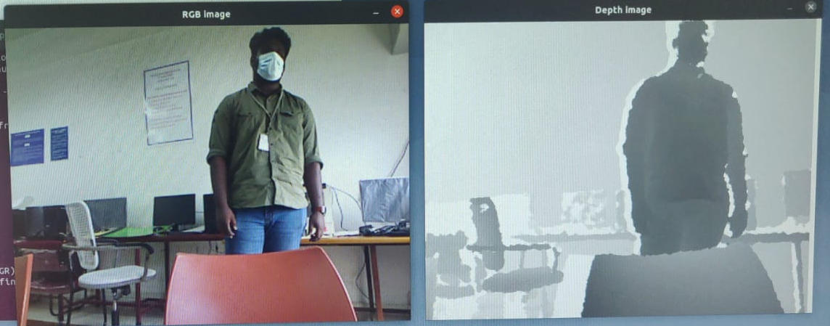
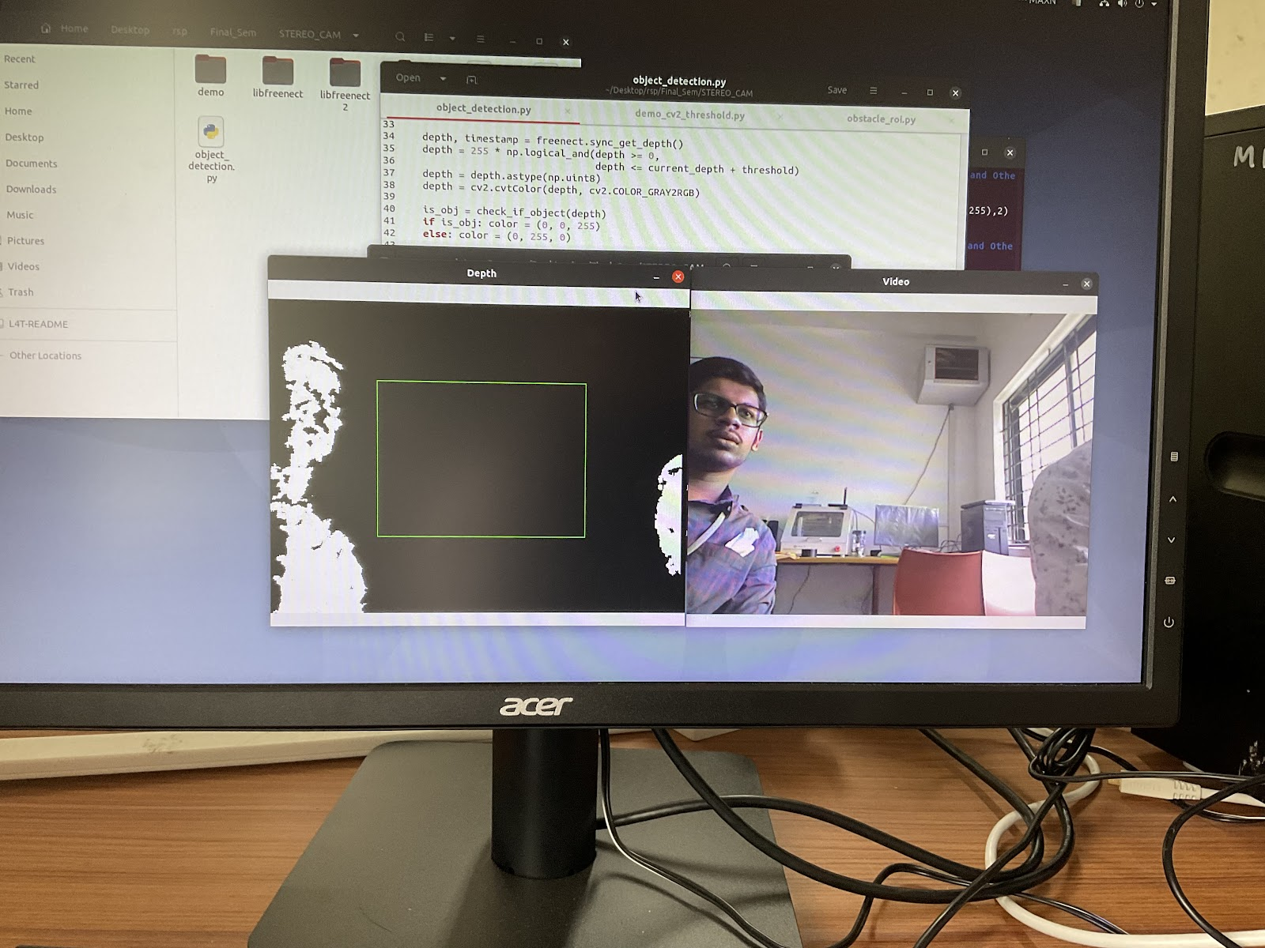
CURRENT PROGRESS
Interfaced with stereo camera (KINECT v1) on Jetson NANO.
Obtained depth map and applied depth threshold to identify nearby objects.
14

Slide 16
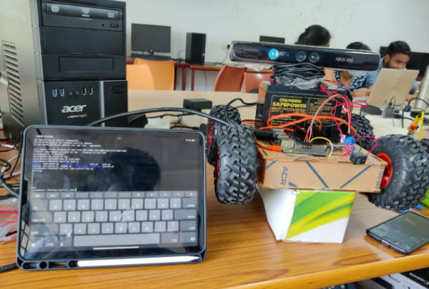
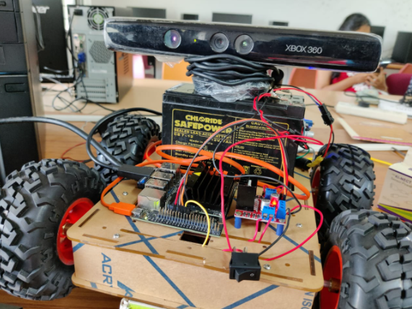
CURRENT PROGRESS
Interfaced with L298N motor driver and enabled four directional movement.
Set up remote access for Jetson NANO using SSH and VNC.
Set up suitable power supply for bot portability.
15

Slide 17
WORK PLAN
First review: Set up testing space. Study available and suitable RL algorithms. Test the performance of the algorithms. | Second Review: Collect data set for plant detection model. Train plant detection model. | Third review: Setup interface for mapping the environment. Testing and optimizing.
16

Slide 18
REFERENCES
Arga Dwi Pambudi,Trihastuti Agustinah and Rusdhianto Effendi,"Reinforcement Point and Fuzzy Input Design of Fuzzy Q-Learning for Mobile Robot Navigation System",International Conference of Artificial Intelligence and Information Technology (ICAIIT),September 2019
Martin Gromniak and Jonas Stenzel ,"Deep Reinforcement Learning for Mobile Robot Navigation", Asia-Pacific Conference on Intelligent Robot Systems (ACIRS),July 2019
Guillaume Sartoretti , Justin Kerr , Yunfei Shi, Glenn Wagner, T. K. Satish Kumar, Sven Koenig, and Howie Choset,“PRIMAL: Pathfinding via Reinforcement and Imitation Multi-Agent Learning”, Ieee robotics and automation letters, , Vol. 4, no. 3, July 2019.
Hyansu Bae , Gidong Kim , Jonguk Kim , Dianwei Qian 4 and Sukgyu Lee , “Multi-Robot Path Planning Method Using Reinforcement Learning”, Multidisciplinary Digital Publishing Institute, Vol 3,No 4, May 2019.
Jing Xin,Huan Zhao,Ding Liu,”Application of Deep Reinforcement Learning in Mobile Robot Path Planning”, Ieee robotics and automation letters, Vol 2, No 3 , January 2019.
17

Slide 19
END OF PRESENTATION

Slide 20
REINFORCEMENT LEARNING BASED AUTOMATED PATH PLANNING IN GARDEN ENVIRONMENT USING DEPTH - 'RAPiG-D'
FIRST REVIEW
S SATHIYA MURTHI - 2018504604
PRANAV BALAKRISHNAN - 2018504581
C ROSHAN ABRAHAM - 2018504591
BE ELECTRONICS AND COMMUNICATION ENGINEERING
GUIDED BY:​
DR. V. SATHIESH KUMAR,​
ASSISTANT PROFESSOR,
DEPARTMENT OF ELECTRONICS ENGINEERING​
MIT CAMPUS, ANNA UNIVERSITY​

Slide 21
TABLE OF CONTENTS
Objectives
Methodology / Block Diagram
Previous progress Recap
Bot Components and HW specs
Current Progress
Problems Faced
Work plan
References
1

Slide 22
OBJECTIVES
To perform hardware implementation of reinforcement learning based path planning to generate a map of an unknown environment by employing depth estimation based obstacle detection and analyze its performance.
To estimate the best possible path to reach a given destination.
2

Slide 23
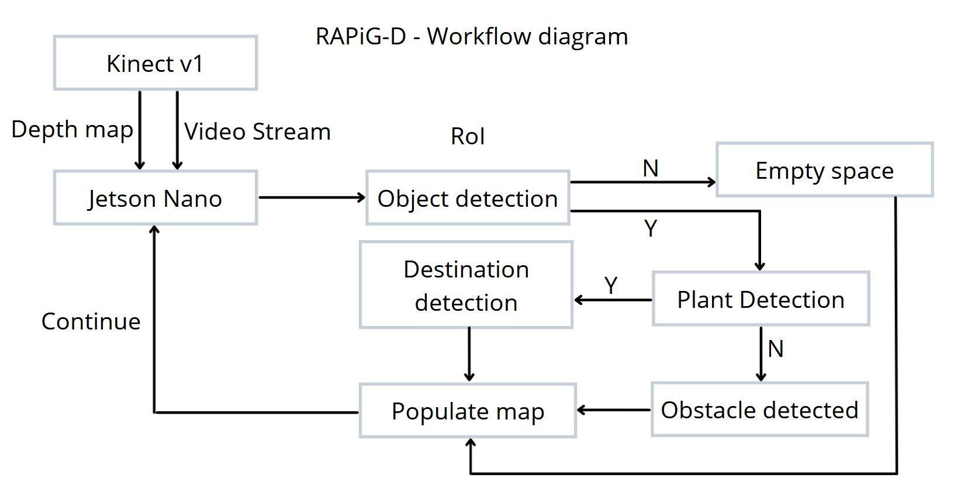
METHODOLOGY
3

Slide 24
PREVIOUS PROGRESS
Tested software implementation of RL SARSA in PC.
Initialised Jetson nano and interfaced with stereo camera (KINECT v1) .
Obtained depth map and applied depth threshold.
Interfaced with L298N motor driver and enabled four directional movement.
Set up basic design of robot.
4

Slide 25
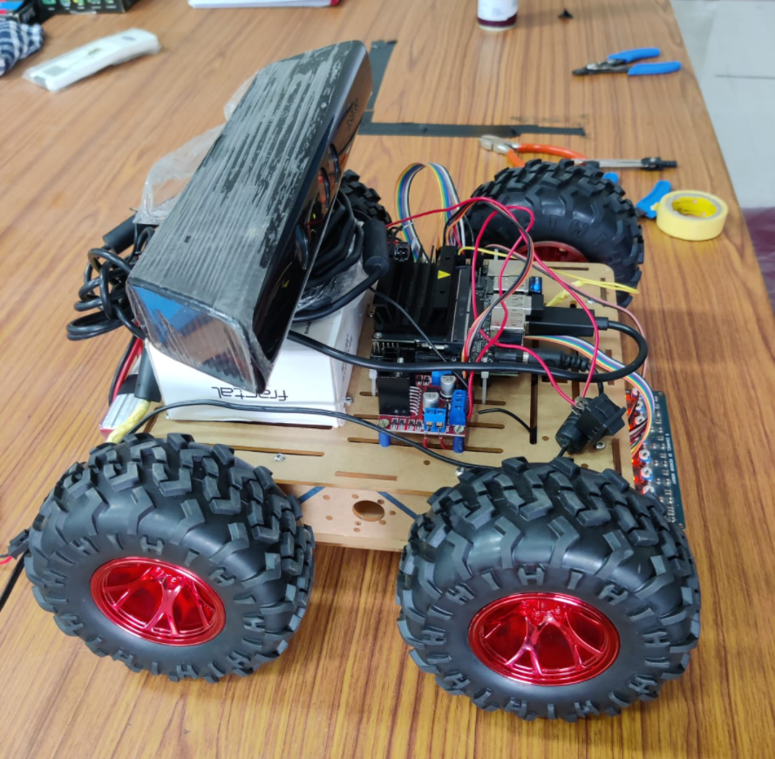
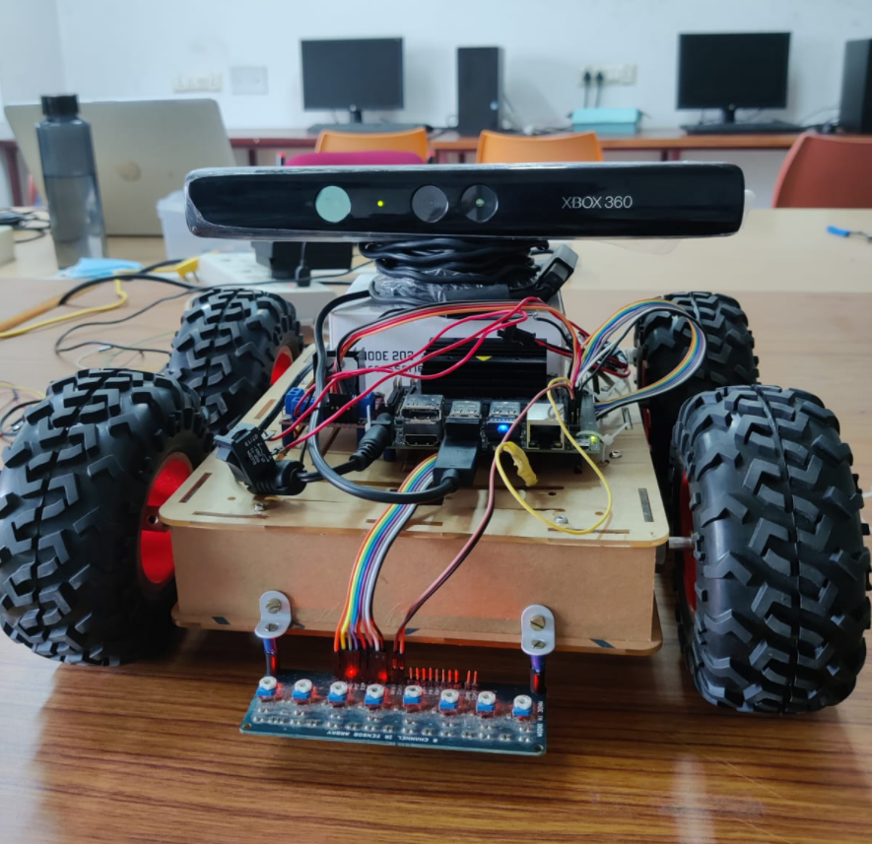
CURRENT BOT
Kinect Camera
Jetson Nano
11.1 V Li-Po
L298N
IR Array
Chassis with 12V Motors
5

Slide 26
COMPONENTS USED
COMPONENTS | SPECIFICATION | NUMBER USED
Jetson Nano | Developer Kit - 4GB | 1
Robot Chassis | Dimensions: 250 x 200 x 46 mm | 1
DC motor | 200 rpm 12V | 2
Wheels | Diameter-130mm Width-60mm | 4
Kinect v1 Camera | Stereo camera, IR camera | 1
Motor Driver IC | L298N | 1
IR sensor | 8 channel array | 1
Battery | 11.1 V 4200mah Li-Po | 1
6

Slide 27
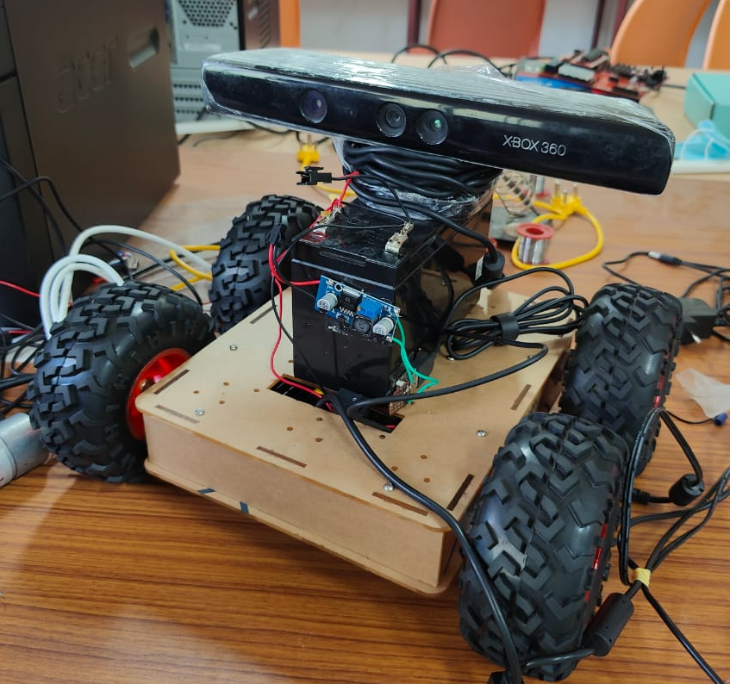
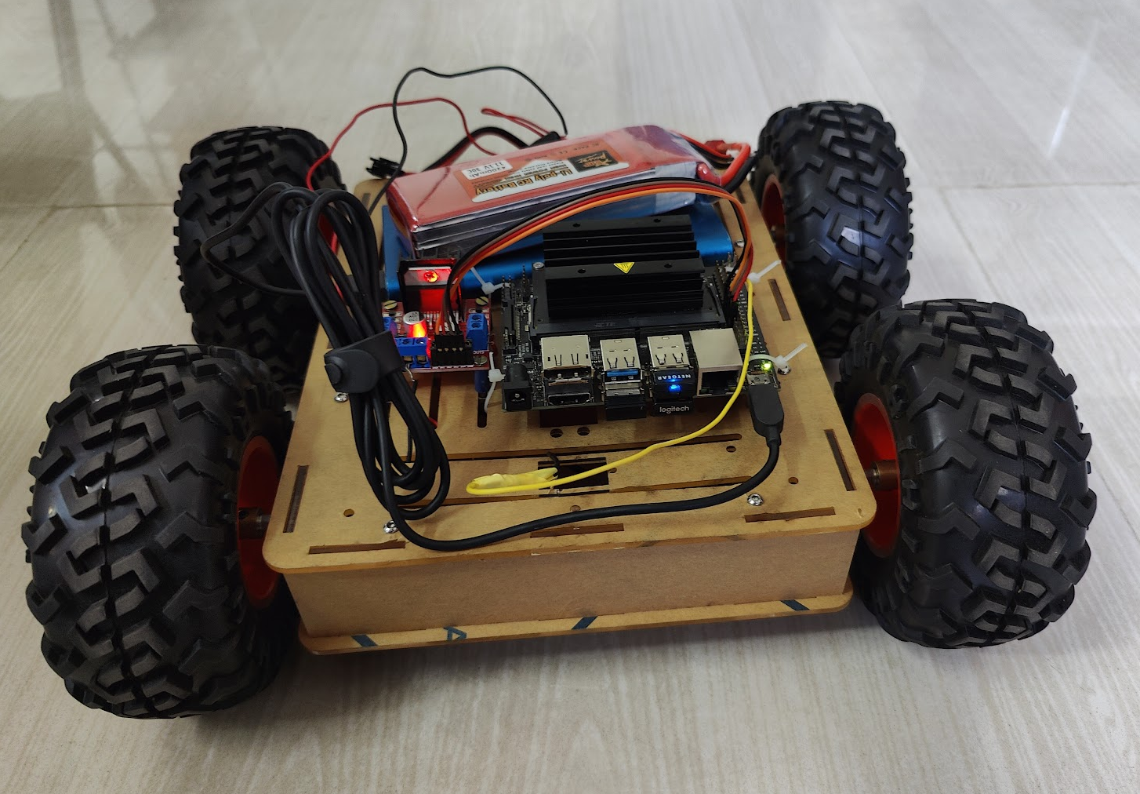
CURRENT PROGRESS
Tried repositioning Jetson nano and motor driver for better weight distribution.
Decided to switch to Li-po battery instead of lead acid 12v battery to power the motor driver.
Set up web output for obstacle detection for remote inference
Tested mono-camera depth estimation using MIDAS model
7

Slide 28
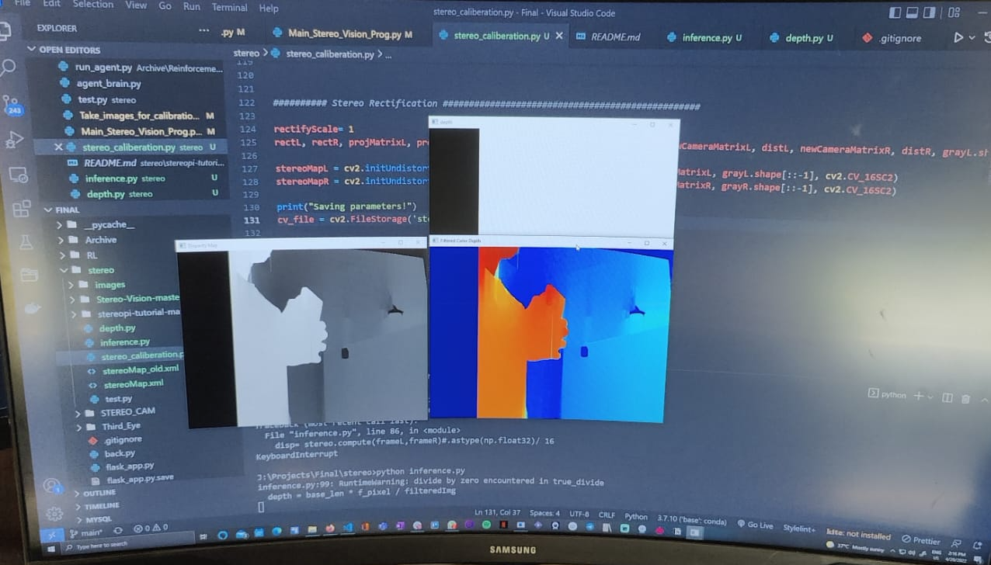
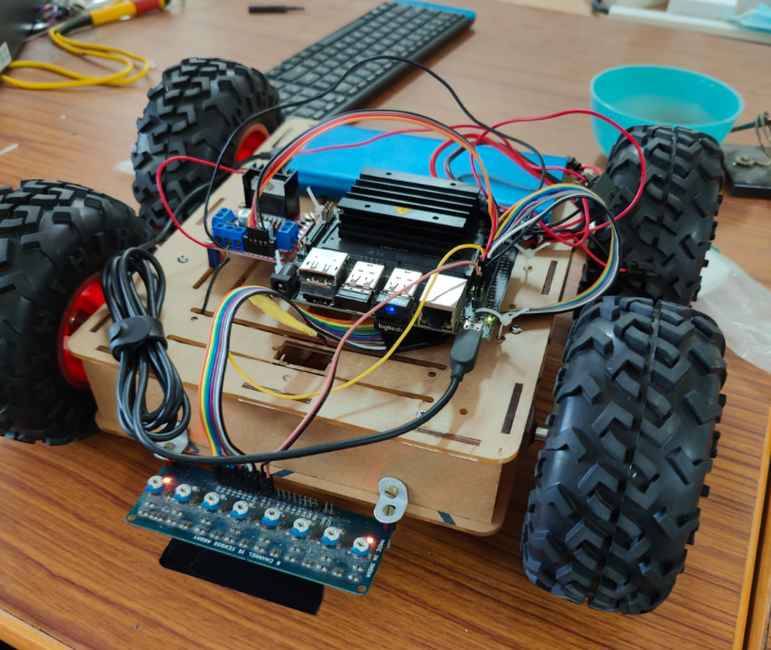
CURRENT PROGRESS
Mounted and used IR sensor array to enable line following for movement calibration. ​
Tested speed control of motor by voltage control using DC-DC converter to improve intersection detection
Implemented stereo camera calibration and depth estimation with two webcams. Performance was not adequate.
8

Slide 29
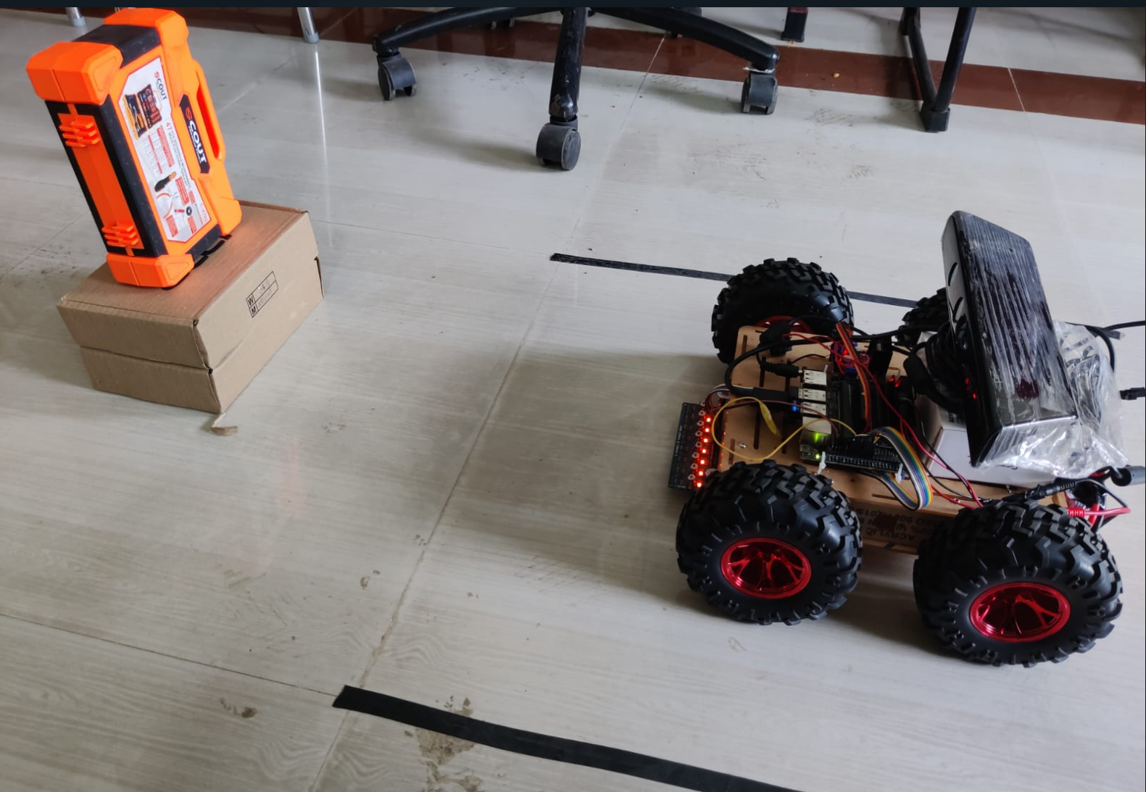
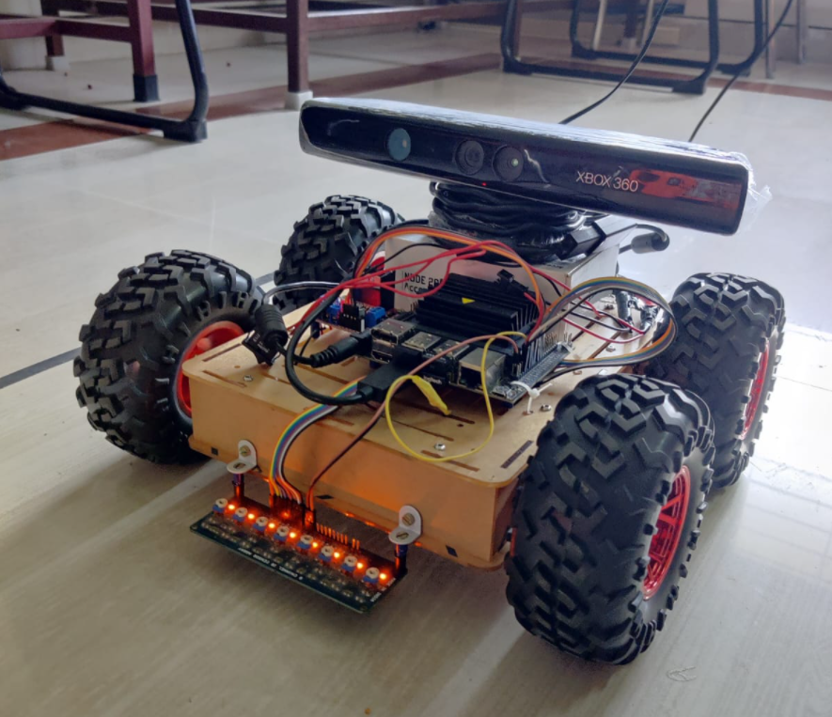
CURRENT PROGRESS
Switched back to Kinect camera
Tested lane detection for movement calibration.
Tried to calibrate turn using line following, timing and detecting line crossing
Optimised object detection to detect obstacles in next cell then integrated it with line following linear movement to set up obstacle mapping in linear space
9

Slide 30
PROBLEMS FACED
Bot movement irregular due to weight and loose shaft
Unable to VNC remotely without display connected. Requires a Dummy HDMI connection.
Jetson nano and Kinect camera not functioning properly when used in battery mode – 12V 7A Lead Acid battery
Stability of bot and calibration is an issue.
Bot doesn’t turn due to the weight of the 12V lead acid battery
Jetson Nano turns off when using Kinect camera when powered by power bank
Bot turning is irregular – Wheels get stuck, skid. Turning inaccurate.
10

Slide 31
WORK PLAN
Second Review: Set up RL algorithm to map 2D space Improve bot stability and calibrate turning | Third review: Setup interface for mapping the environment remotely. Testing and optimizing.
11

Slide 32
REFERENCES
Arga Dwi Pambudi, Trihastuti Agustinah and Rusdhianto Effendi, "Reinforcement Point and Fuzzy Input Design of Fuzzy Q-Learning for Mobile Robot Navigation System",International Conference of Artificial Intelligence and Information Technology (ICAIIT),September 2019
Martin Gromniak and Jonas Stenzel ,"Deep Reinforcement Learning for Mobile Robot Navigation", Asia-Pacific Conference on Intelligent Robot Systems (ACIRS),July 2019
Guillaume Sartoretti , Justin Kerr , Yunfei Shi, Glenn Wagner, T. K. Satish Kumar, Sven Koenig, and Howie Choset,“PRIMAL: Pathfinding via Reinforcement and Imitation Multi-Agent Learning”, Ieee robotics and automation letters, , Vol. 4, no. 3, July 2019.
Hyansu Bae , Gidong Kim , Jonguk Kim , Dianwei Qian 4 and Sukgyu Lee , “Multi-Robot Path Planning Method Using Reinforcement Learning”, Multidisciplinary Digital Publishing Institute, Vol 3,No 4, May 2019.
Jing Xin,Huan Zhao,Ding Liu,”Application of Deep Reinforcement Learning in Mobile Robot Path Planning”, Ieee robotics and automation letters, Vol 2, No 3 , January 2019.
12

Slide 33
END OF PRESENTATION

